Slide 1
Testing In GO
How to write efficient unit test
songjiayang@JDCloud

Slide 2
Agenda
Why Unit Test
Basic Knowledge
Table Testing
Testing HTTP
Other Packages
Other Mock Packages
Testing with Docker

Slide 3
Why Unit Test
Find
Debug
Refactor
Improve
Reduce
Finds bugs early
Debugging process
Avoids breaking old code
Quality of code
Reduce costs
Makes the process agile
…..
Make agile
Reference https://dzone.com/articles/top-8-benefits-of-unit-testing

Slide 4

So, Unit test should be a consensus !

Slide 5

But, Why not yet

Slide 6
Why not yet
Lack of basic knowledge
Don't know how to use tools
Don't know how to mock
Writing not boring unit tests not easy

Slide 7
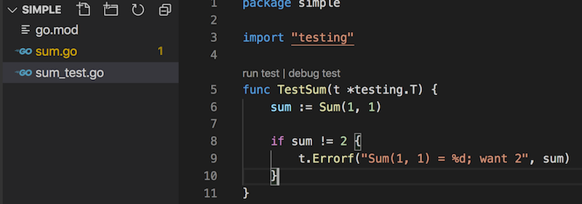
Basic knowledge
https://golang.org/pkg/testing
Tests are written on files ending with "_test.go"
Test function starts with Test* and has only the parameter *testing.T
Use go test command to run your tests

Slide 8
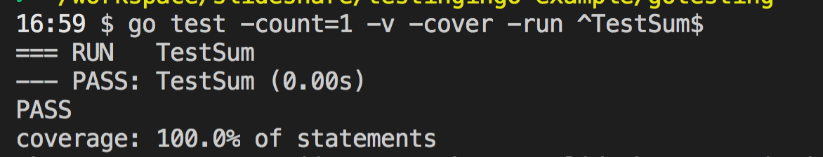
go test
https://golang.org/pkg/cmd/go/internal/test/
go test // testing the local package
go test some/pkg // testing a specific package
go test some/pkg/… // testing a specific package in recursive
go test -v some/pkg –run ^TestSum$ // runs a specified tests
go test -cover // code coverage
go test -count=1 // testing without cache
….

Slide 9
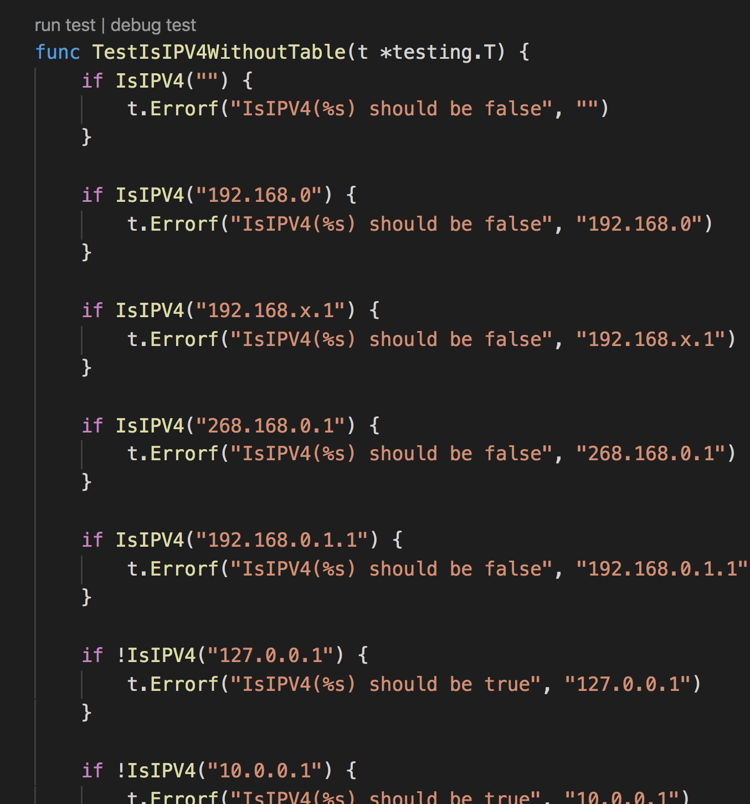
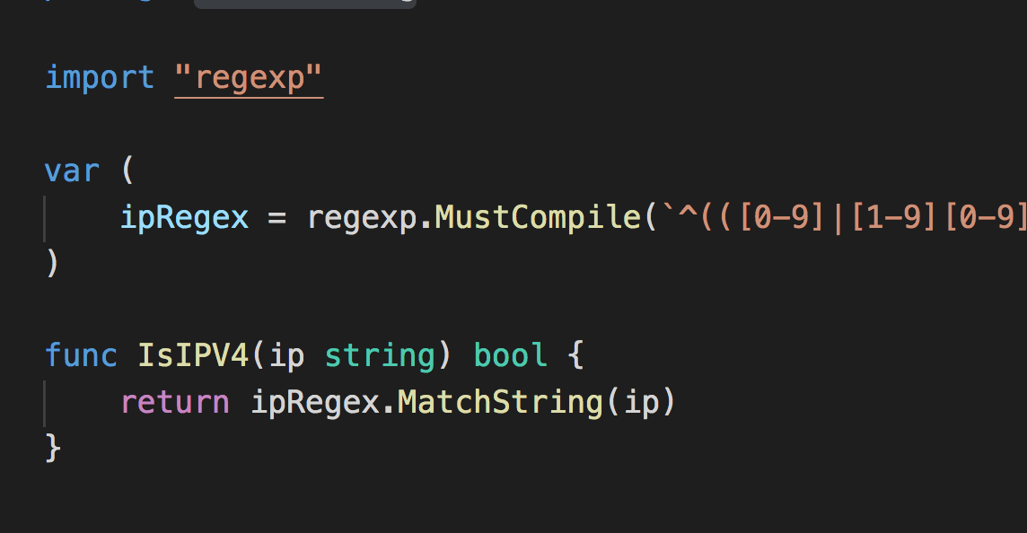
Table Testing
A example about IPV4 regexp:
`^(([0-9]|[1-9][0-9]|1[0-9]{2}|2[0-4][0-9]|25[0-5])\.){3}([0-9]|[1-9][0-9]|1[0-9]{2}|2[0-4][0-9]|25[0-5])$`
REPETITION

Slide 10
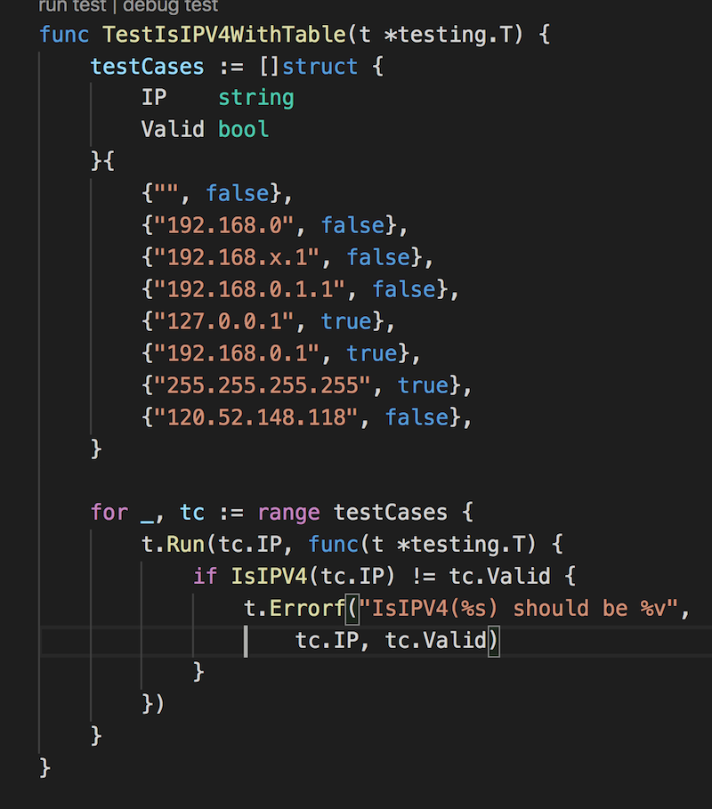
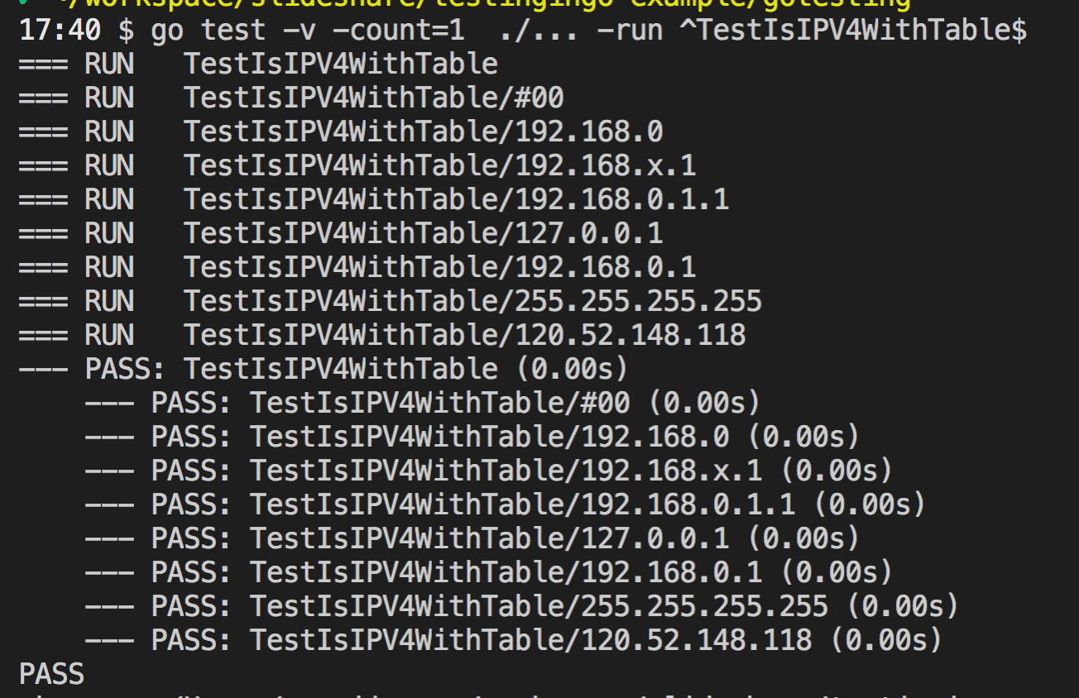
Table Testing
Using anonymous structs to represent test cases
Using Subtests with t.Run

Slide 11
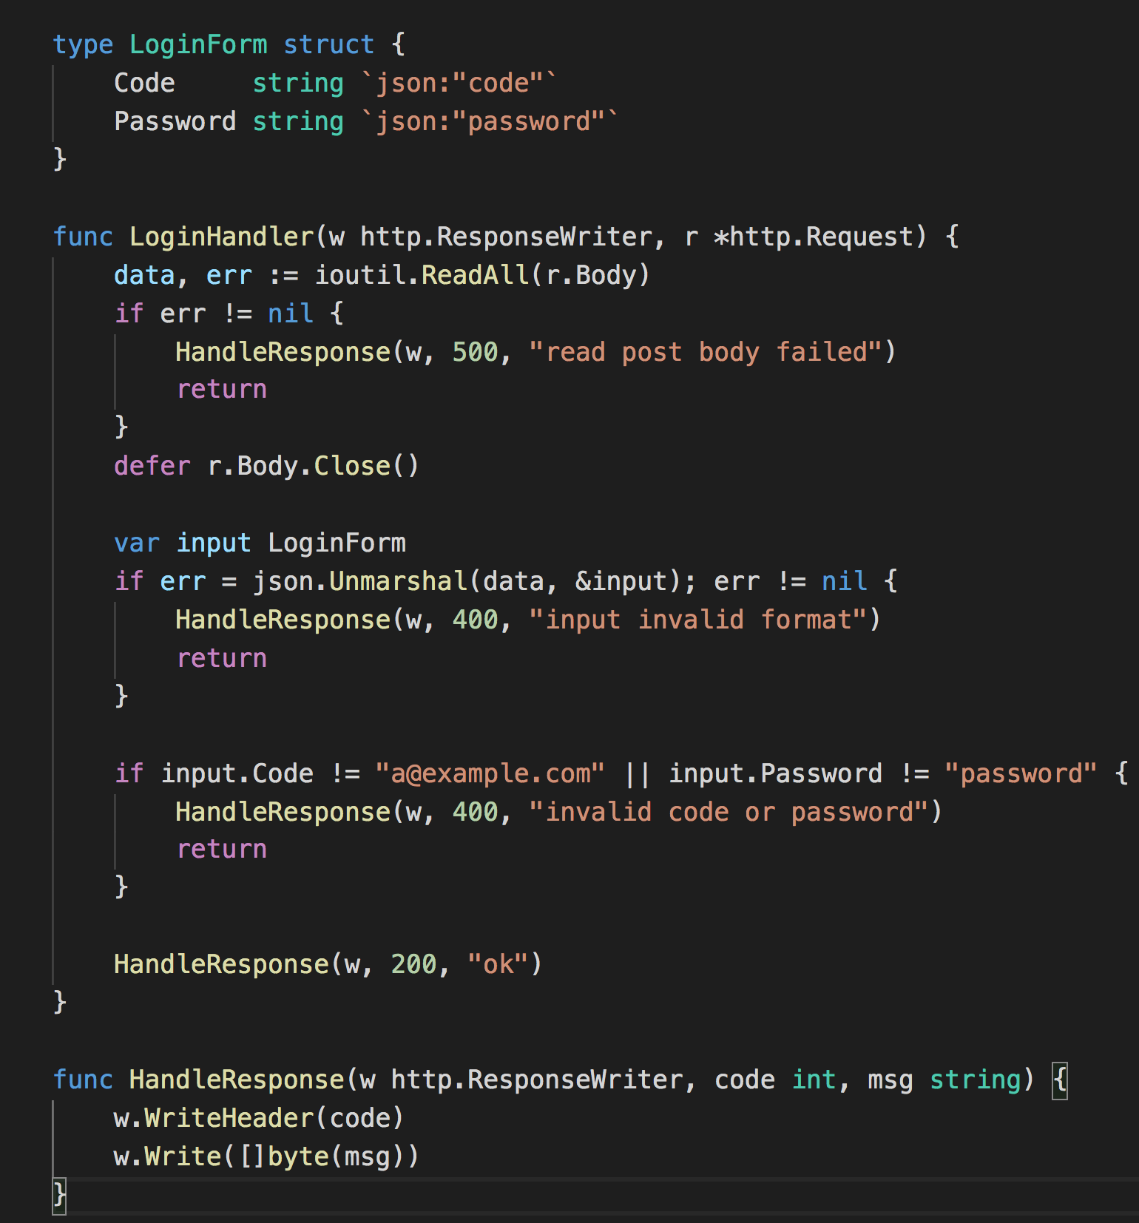
Testing HTTP
A example about user login
Read body
Unmarshal LoginForm
Check Input data

Slide 12
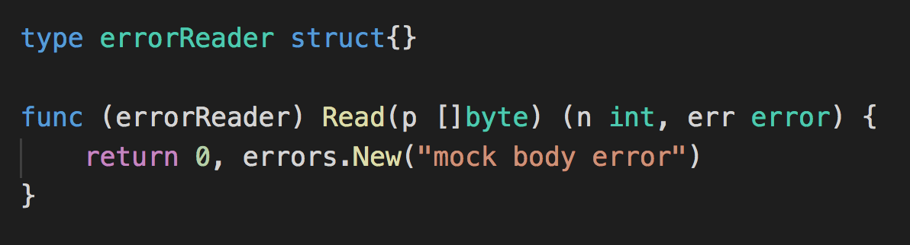
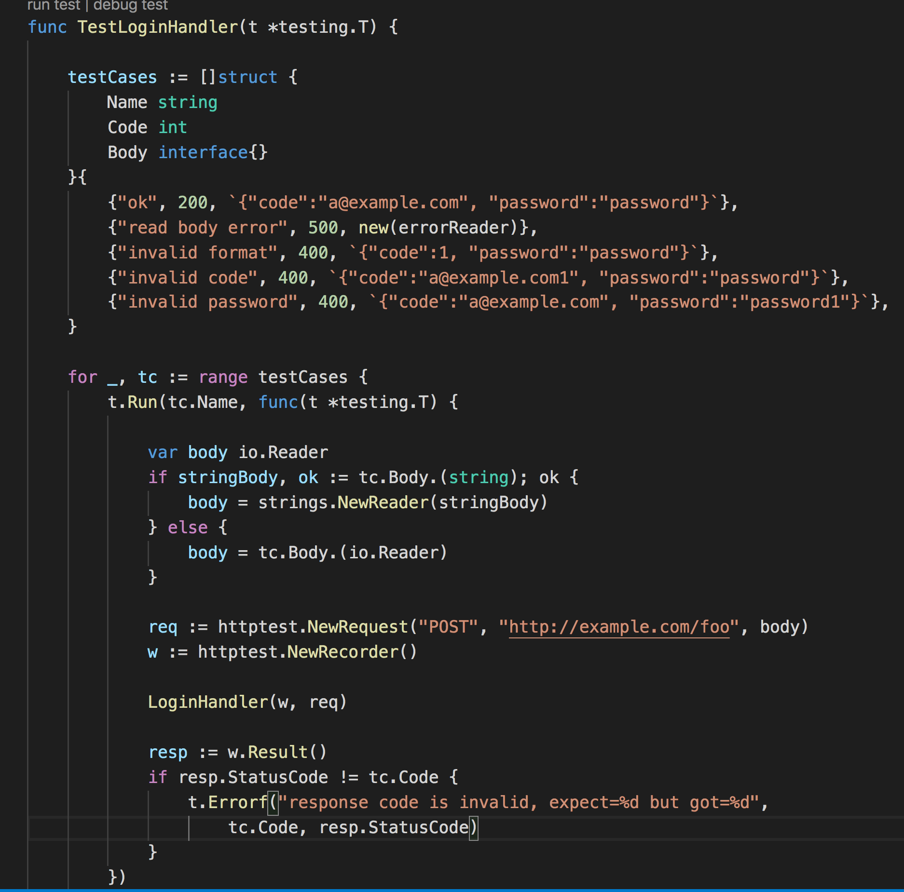
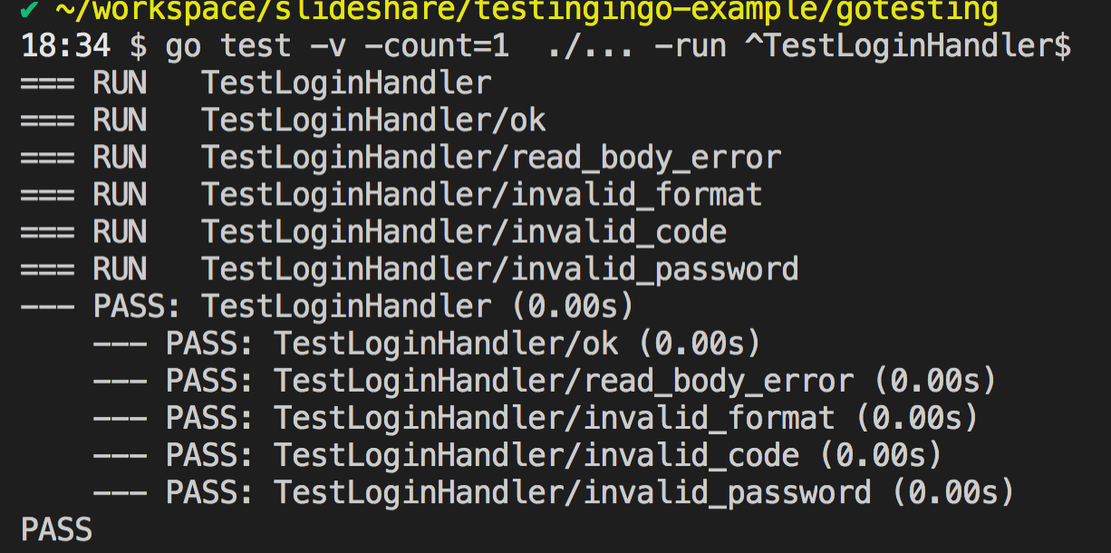
Testing HTTP
https://golang.org/pkg/net/http/httptest
Use httptest.NewRecorder no need listen
Use errorReader to improve coverage

Slide 13
Other Packages

Slide 14
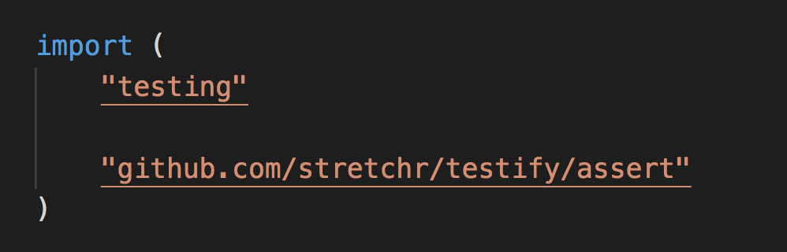
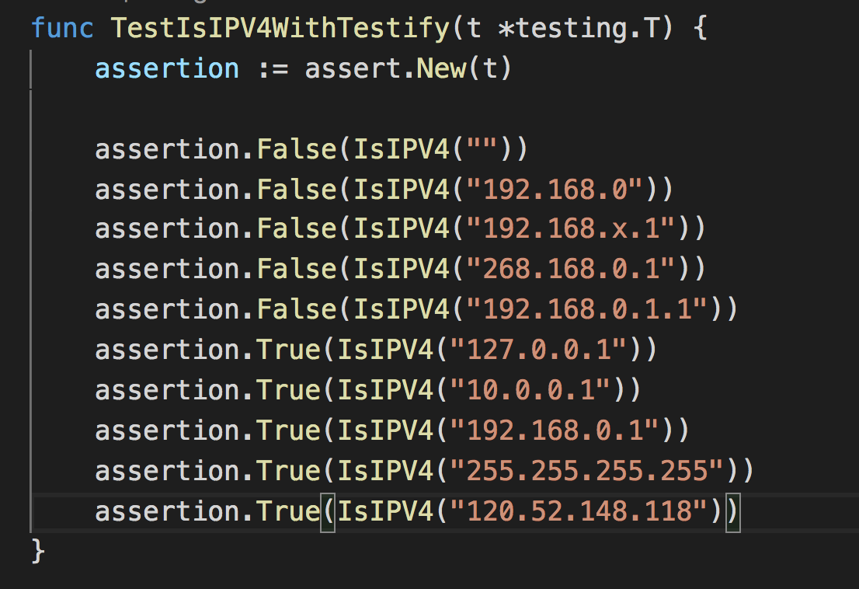
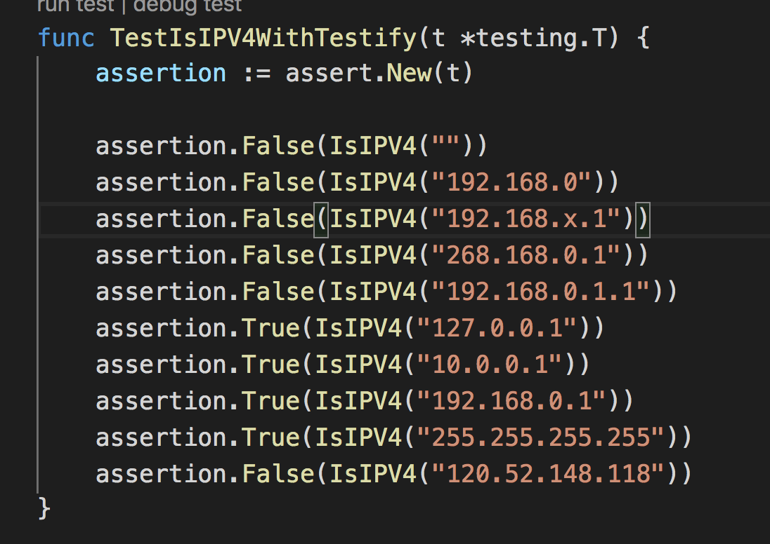
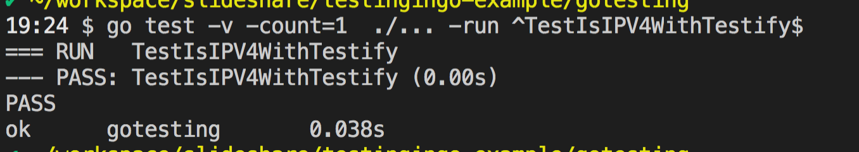
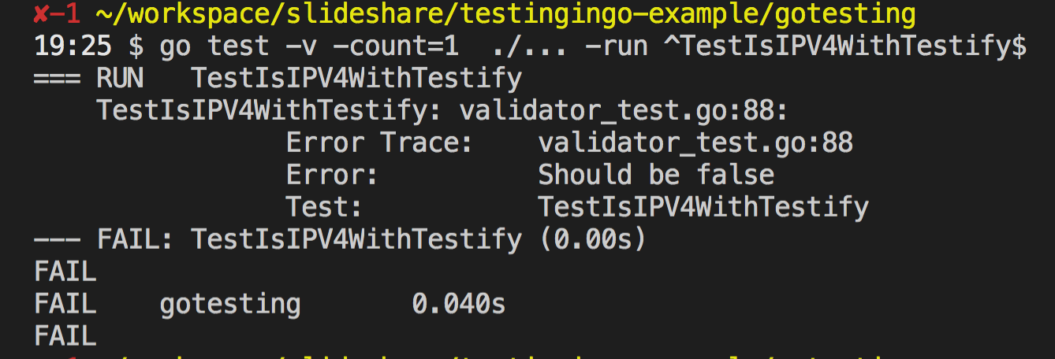
Testify
https://github.com/stretchr/testify (10k+ stars)
Run within go test
Assertions, mostly shortcuts
Mocking

Slide 15
GinkGo
https://github.com/onsi/ginkgo (4k stars)
https://en.wikipedia.org/wiki/Behavior-driven_development
BDD
Work with go test, but has it's own structure
Uses a custom lib for assertion (Gomega)
Rerun testes on change

Slide 16
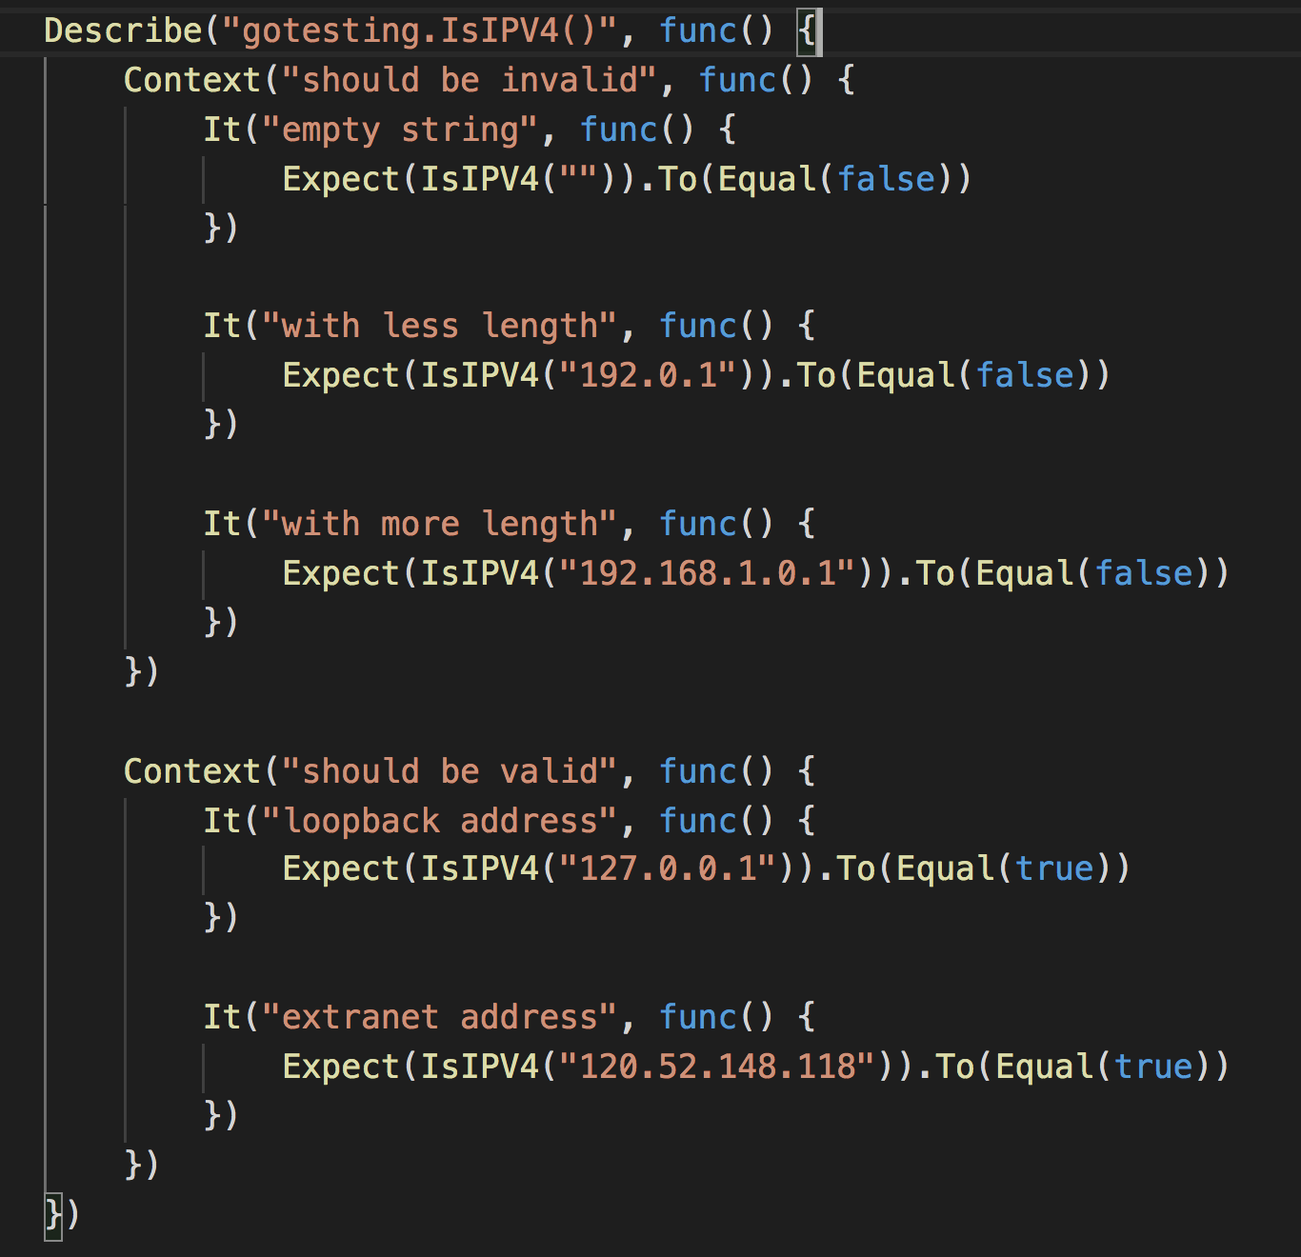
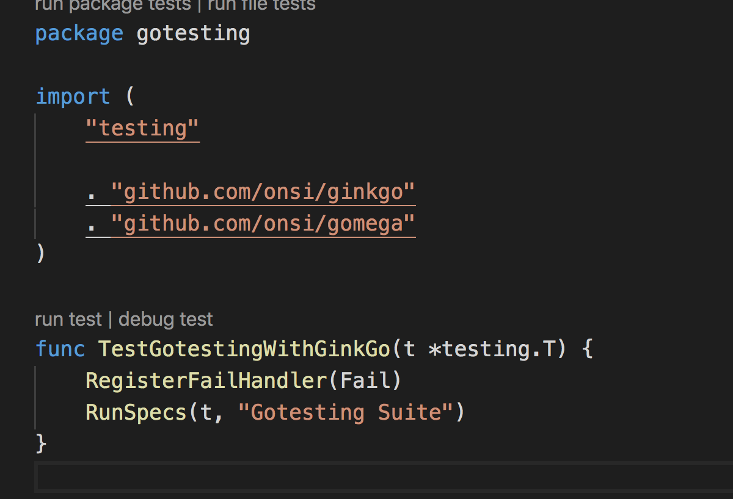
GinkGo
ginkgo bootstrap
ginkgo generate gotesting
ginkgo || go test
ginkgo watch

Slide 17
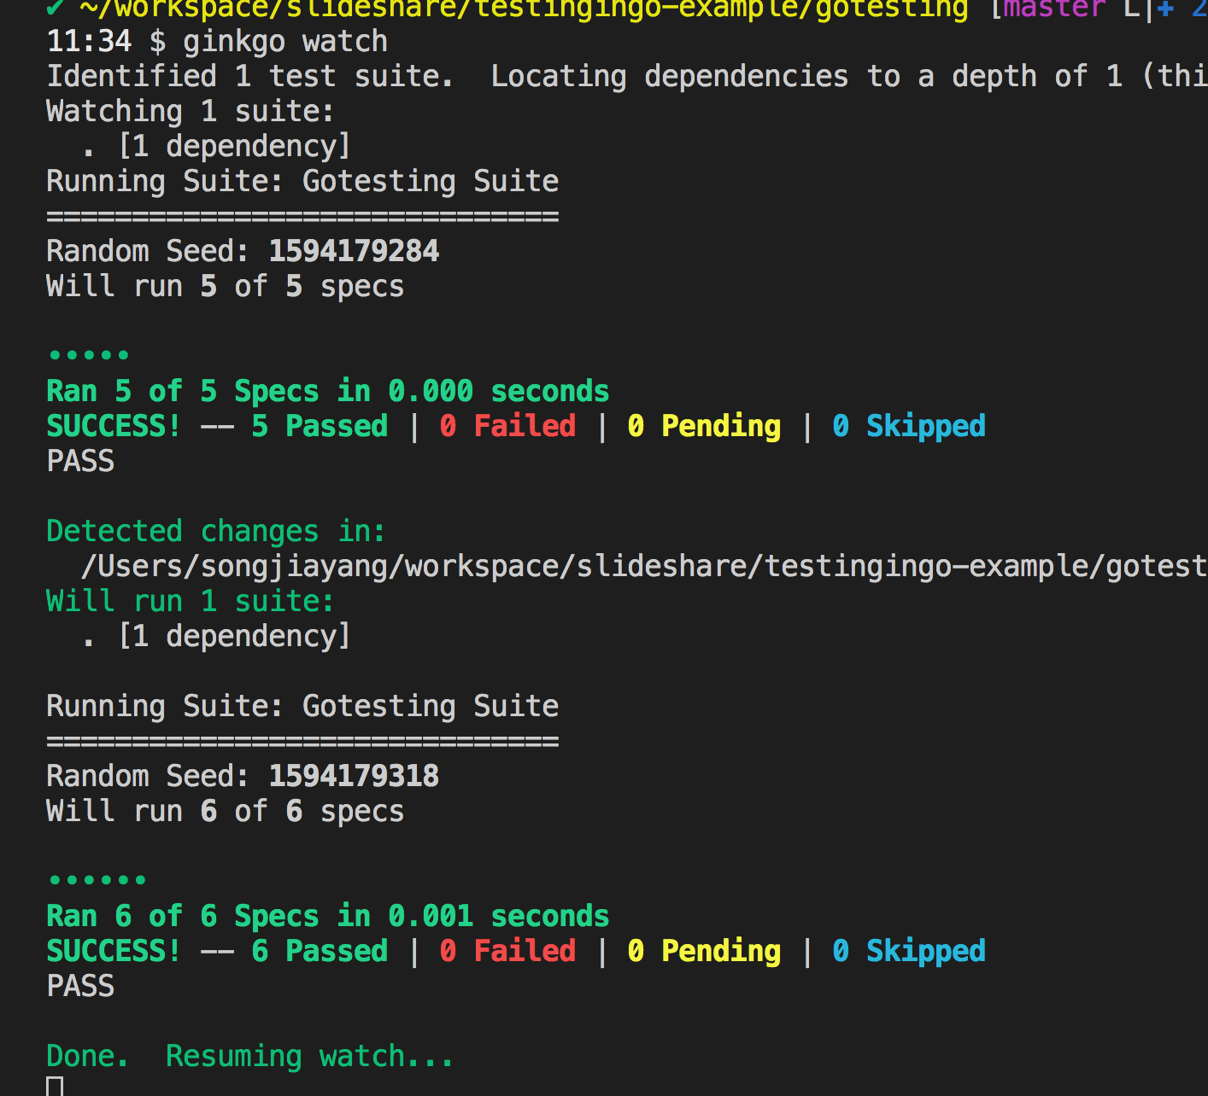
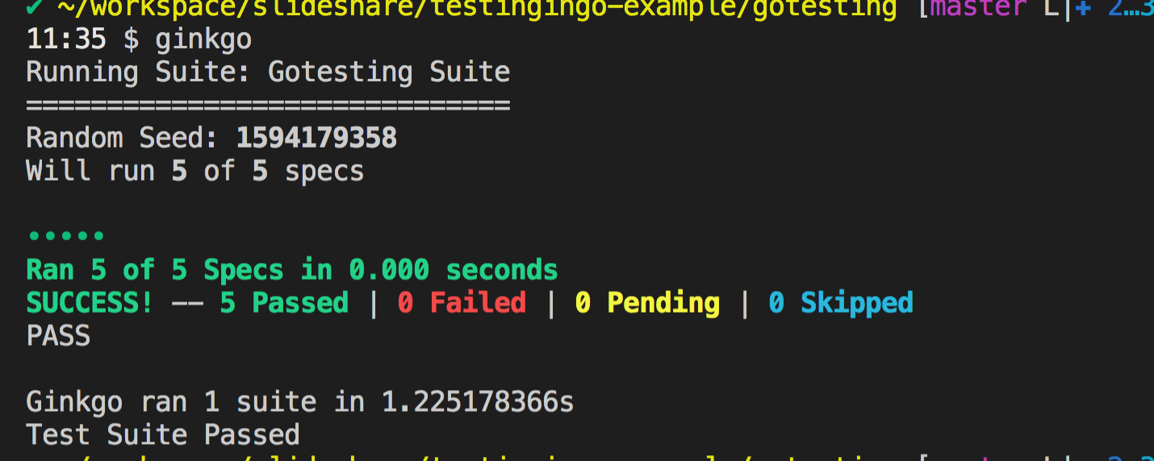
GinkGo
ginkgo bootstrap
ginkgo generate gotesting
ginkgo || go test
ginkgo watch

Slide 18
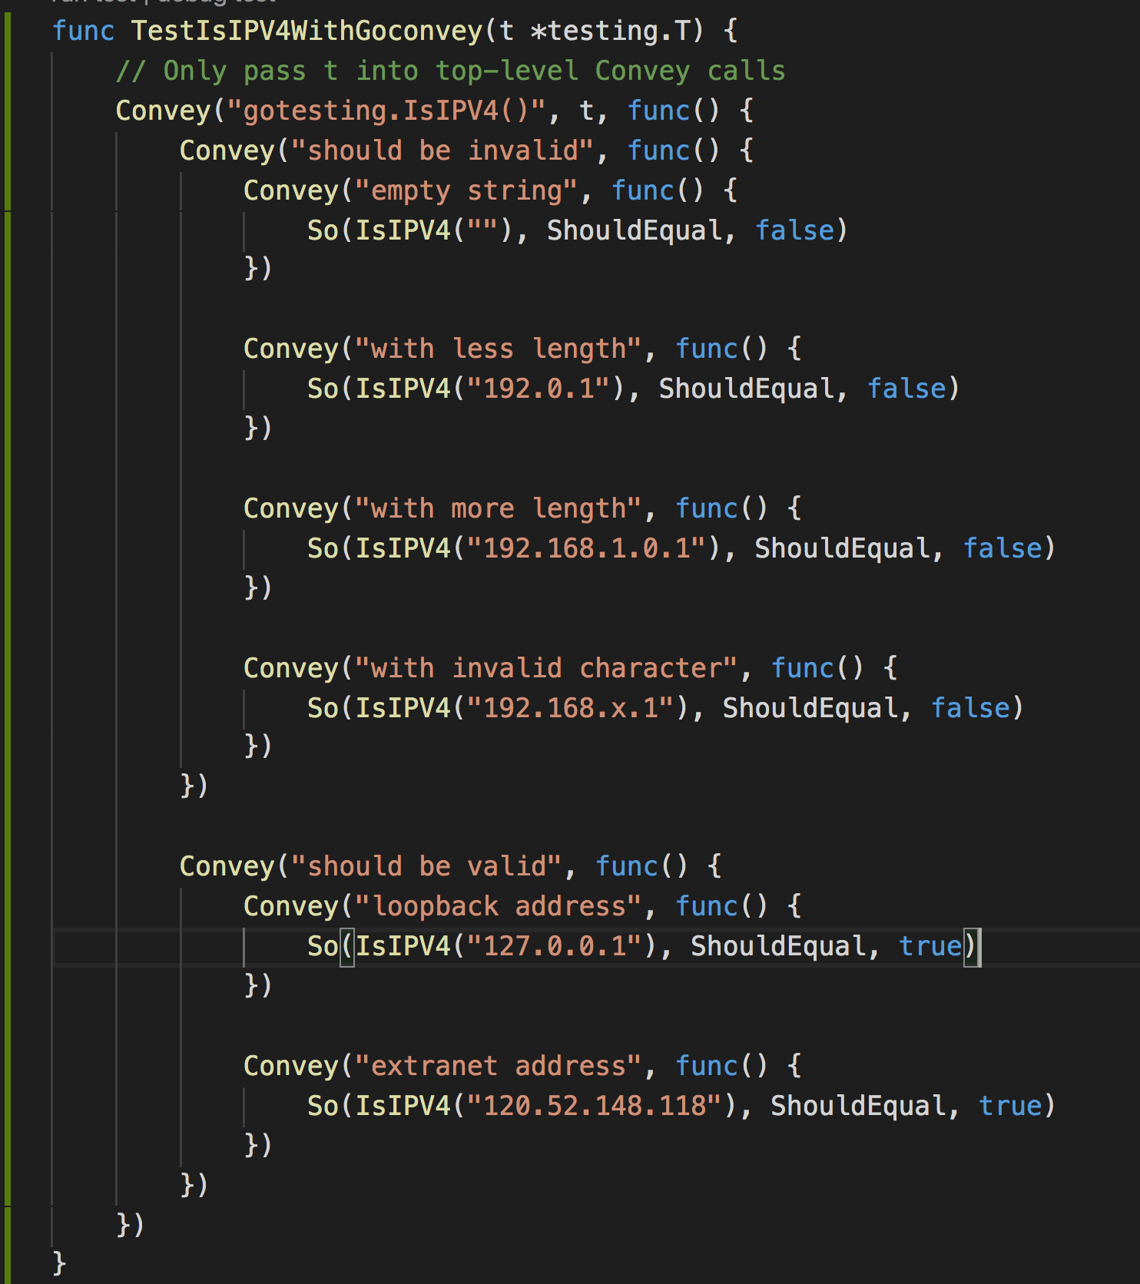
GoConvey
https://github.com/smartystreets/goconvey (5.7k stars)
BDD alike
Work with go test
Pretty browser interface
Reload tests on file changes
Custom DSL
goconvey || go test

Slide 19
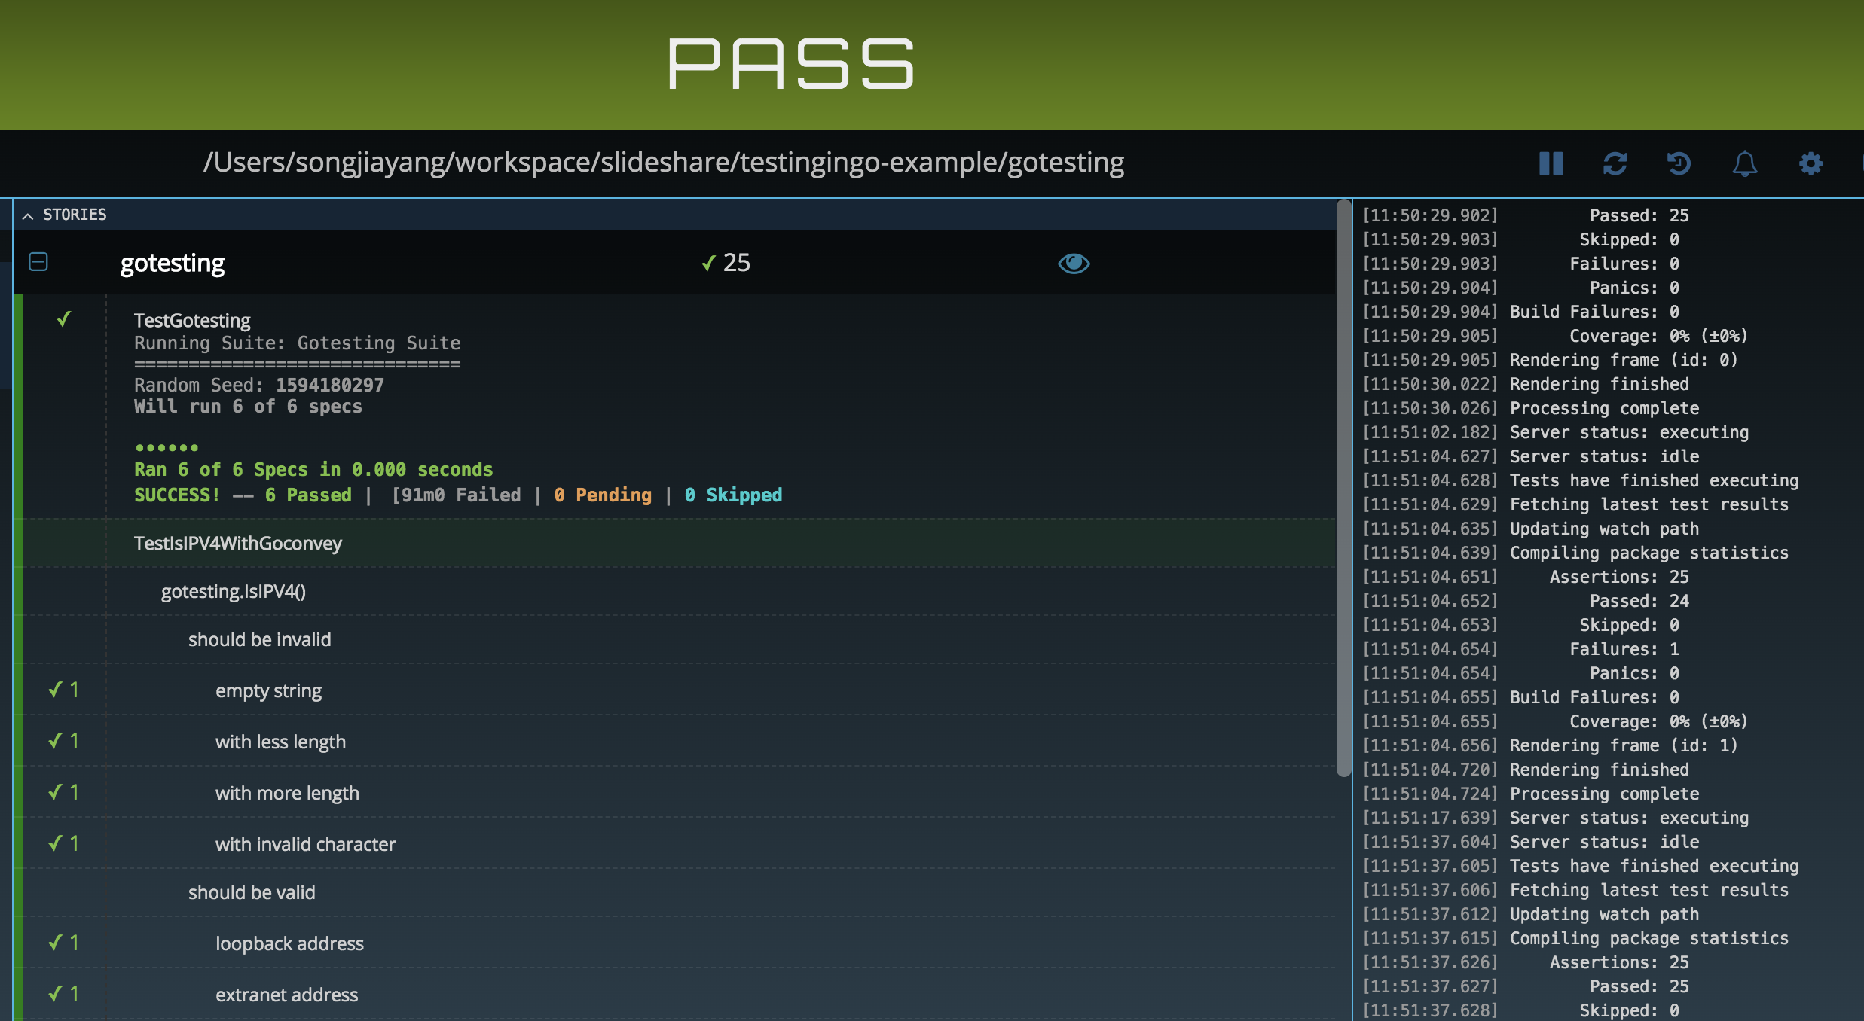
GoConvey
http://127.0.0.1:8080/

Slide 20
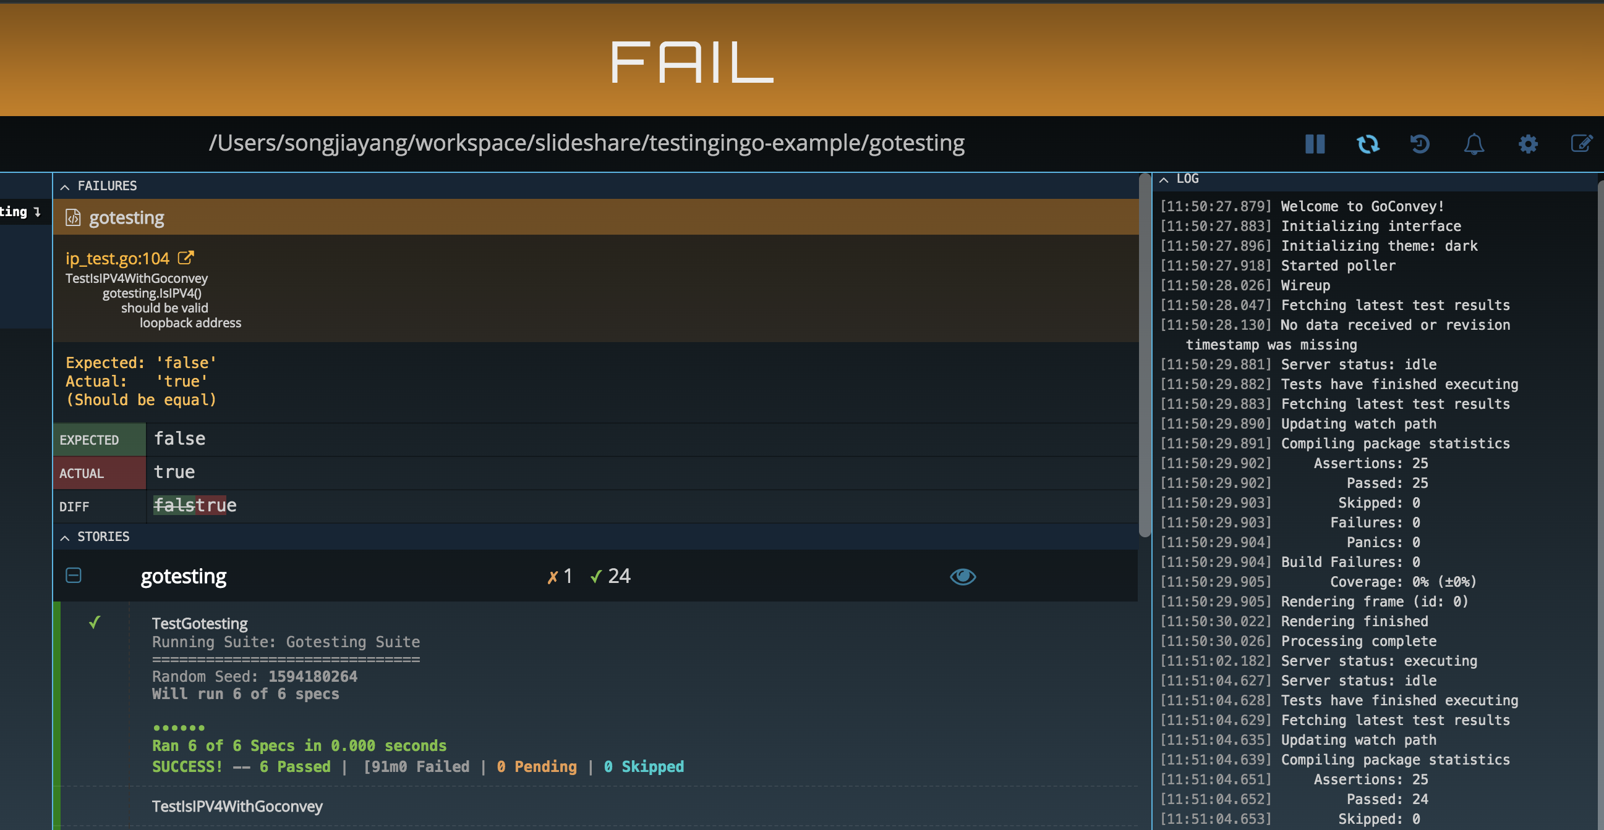
GoConvey
http://127.0.0.1:8080/

Slide 21
Other Mock Packages

Slide 22
GoMock
https://github.com/golang/mock
Official library
An interface mock
Mock and stub support
Generate code with command `mockgen`
mockgen -source=../post/post.go -destination=mock_post_test.go -package=gomocktesting

Slide 23
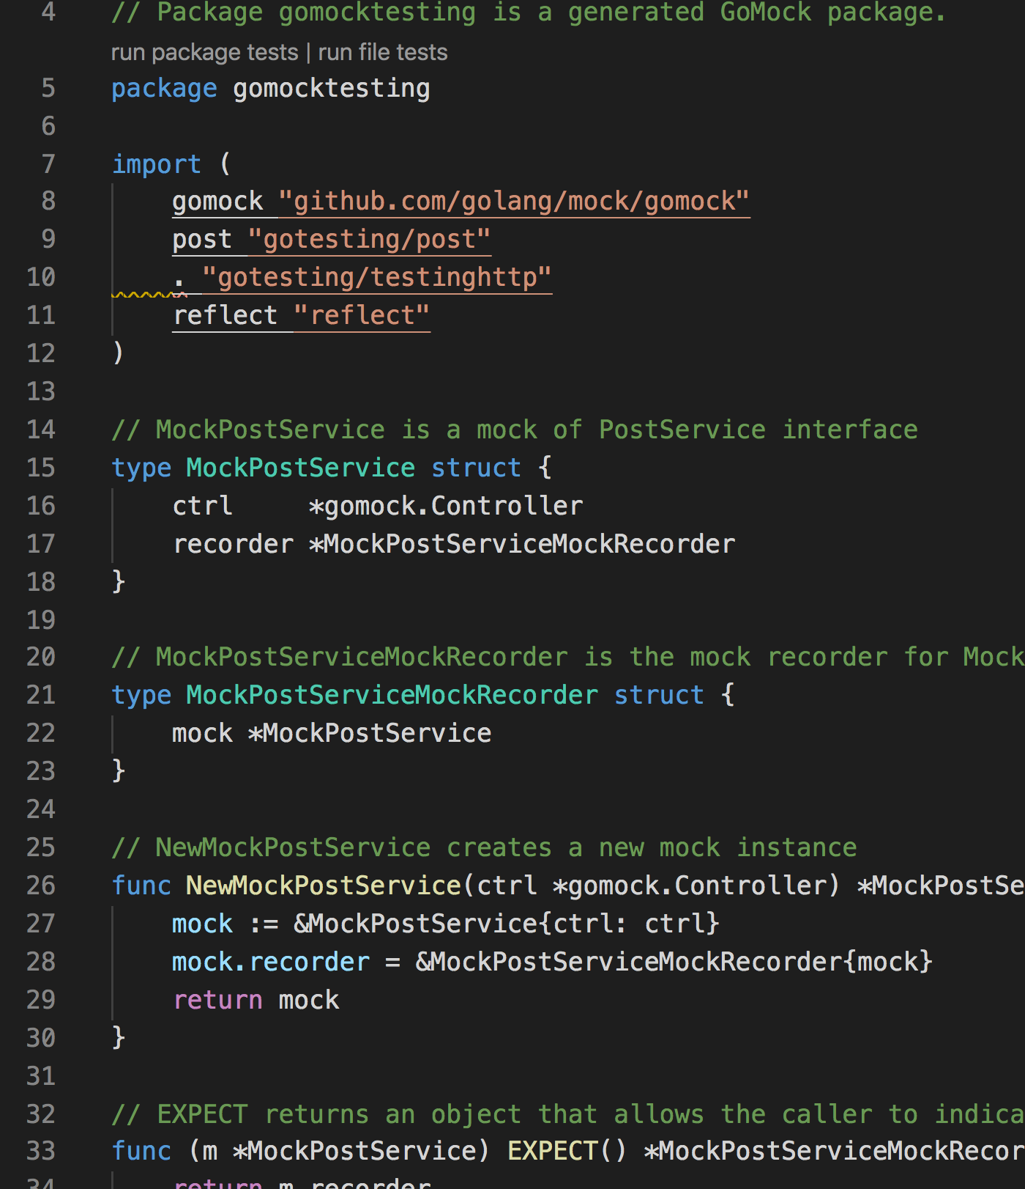
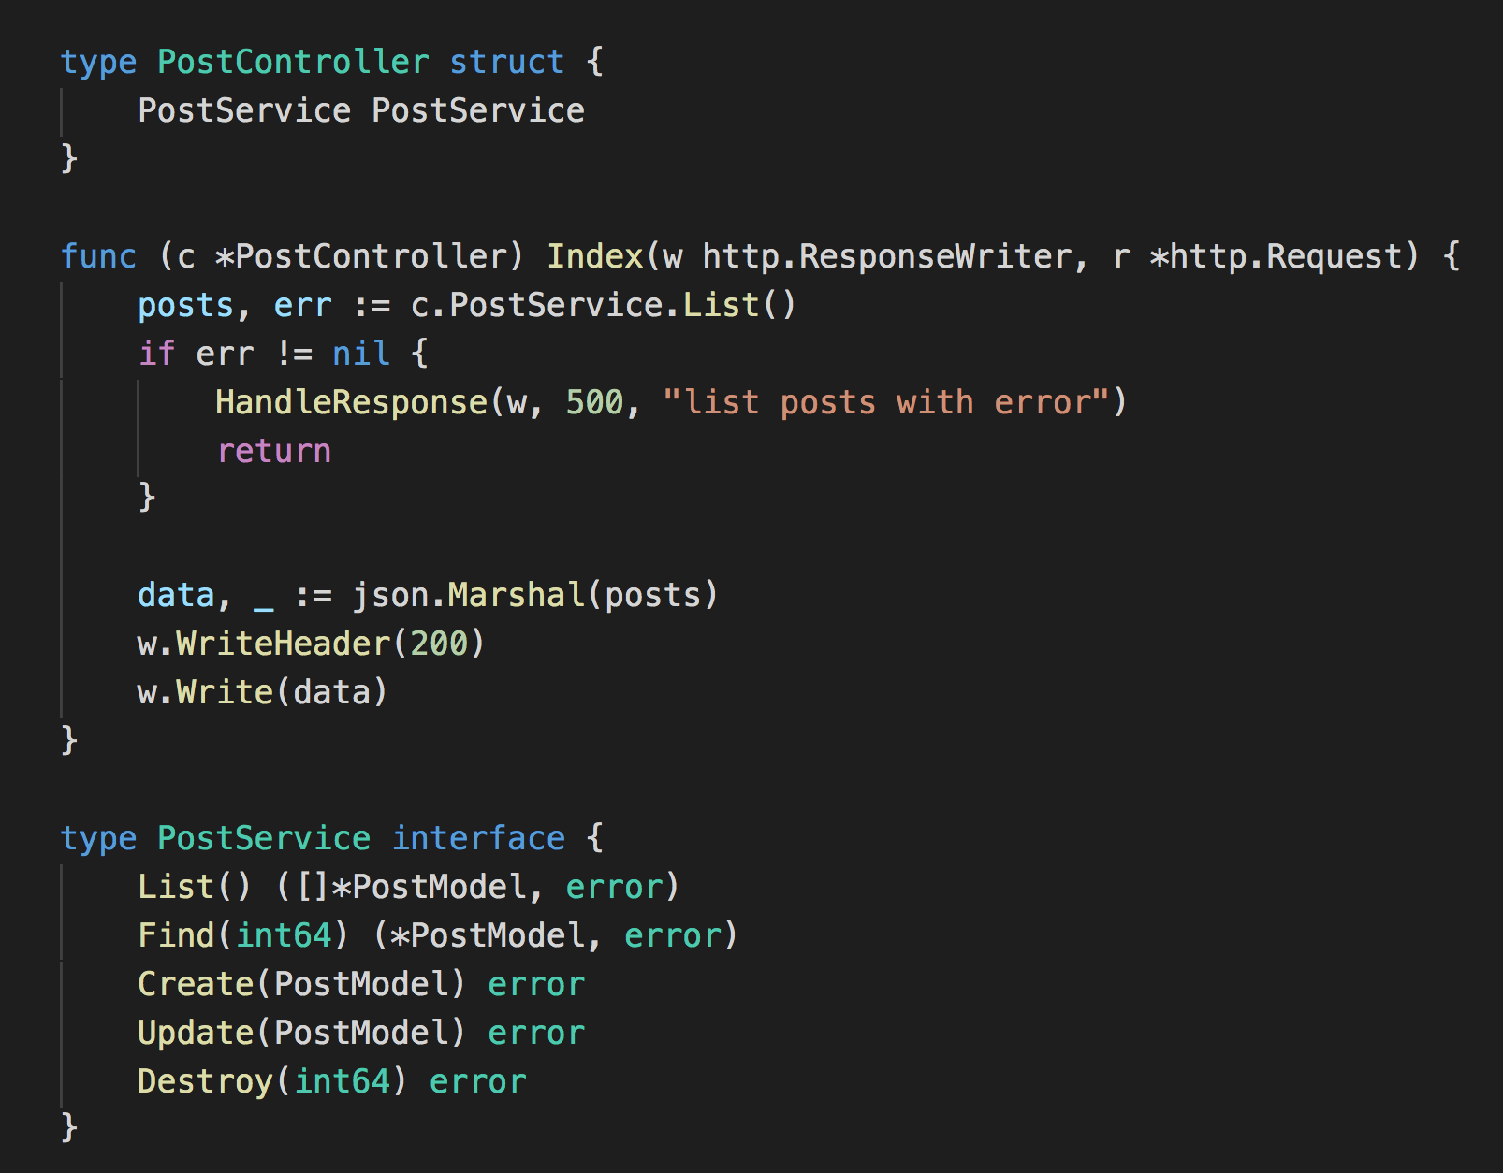
GoMock
A example about PostService

Slide 24
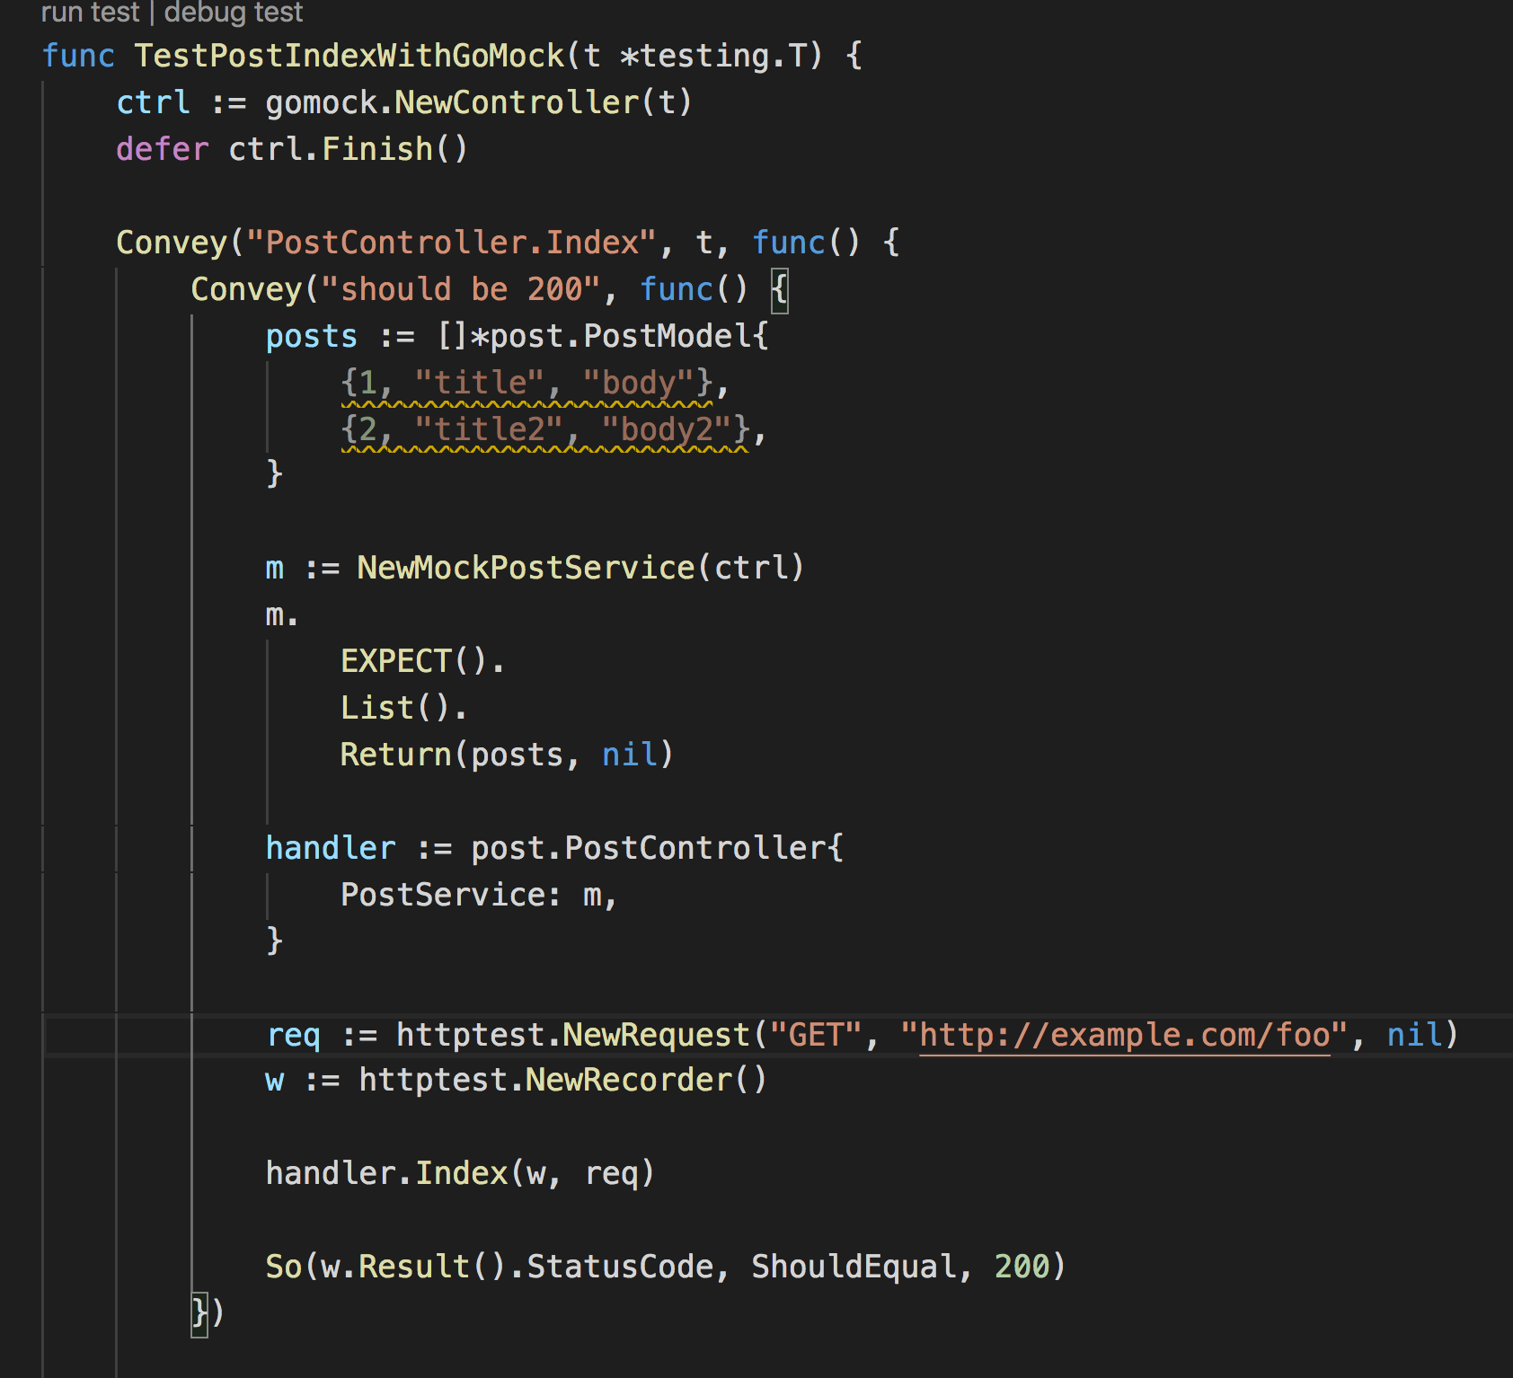
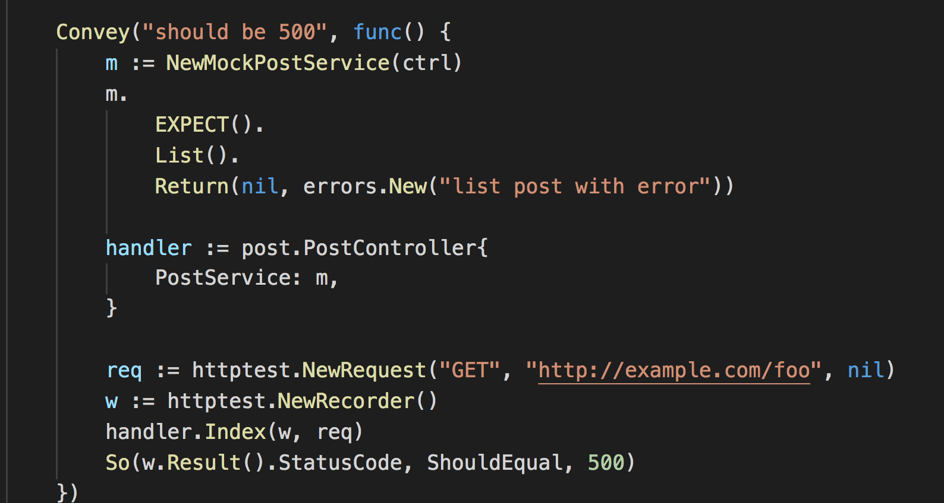
GoMock

Slide 25
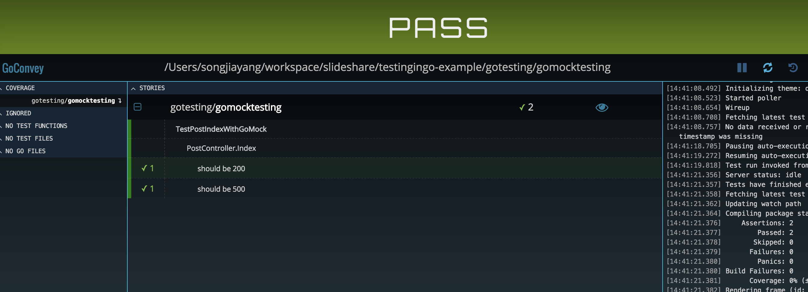
GoMock

Slide 26
HTTPMock
https://github.com/jarcoal/httpmock
Mock http request
Custom any response
Base URL regular matching

Slide 27
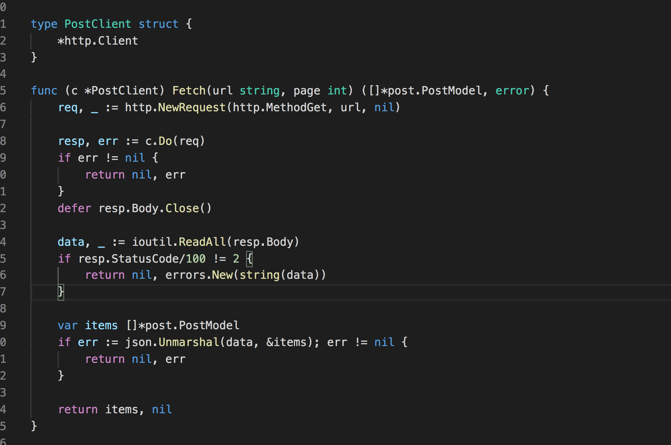
HTTPMock
A example about post client to fetch items and unmarshal

Slide 28
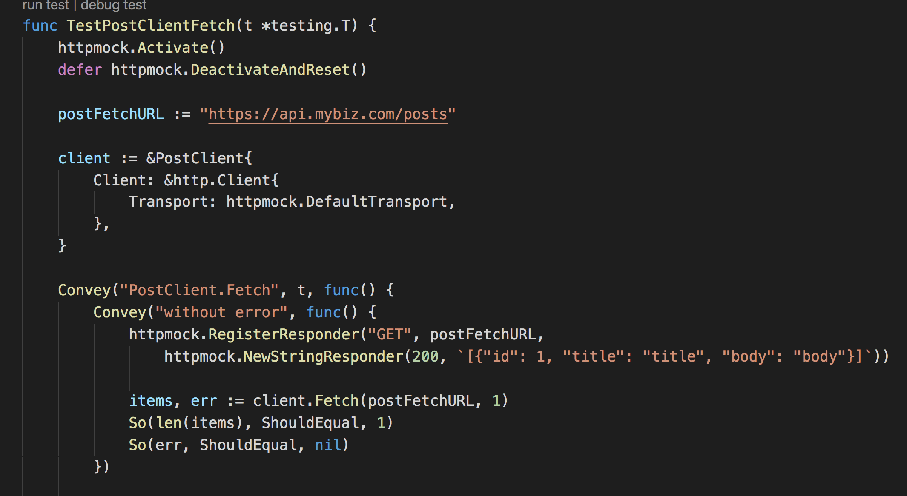
HTTPMock

Slide 29
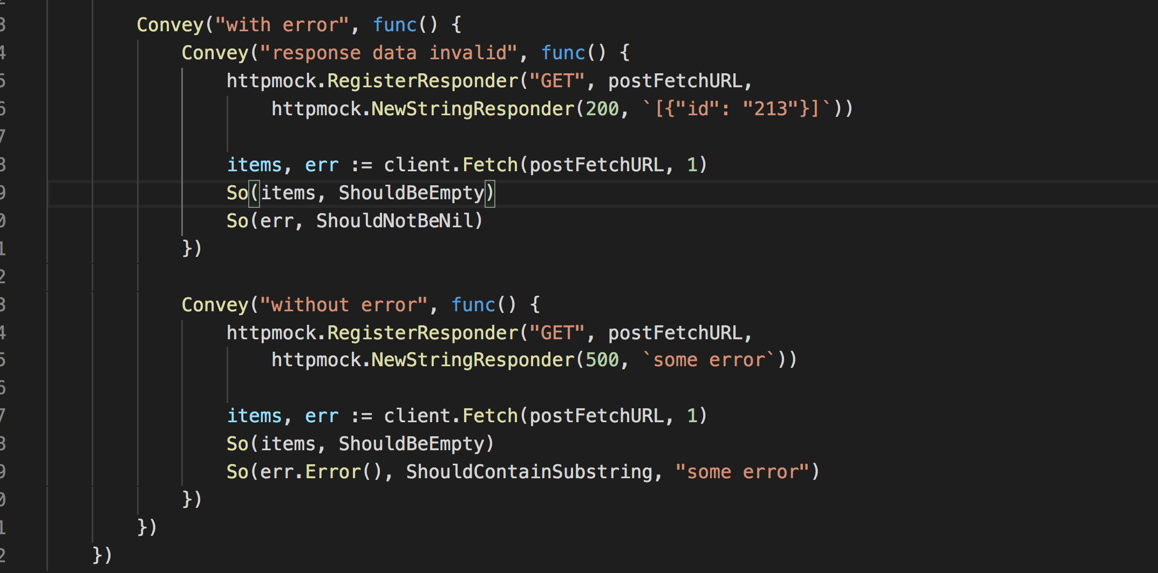
HTTPMock

Slide 30
SQLMock
https://github.com/DATA-DOG/go-sqlmock
Mock for database/sql
Base regular matching
Support query, exec, transaction

Slide 31
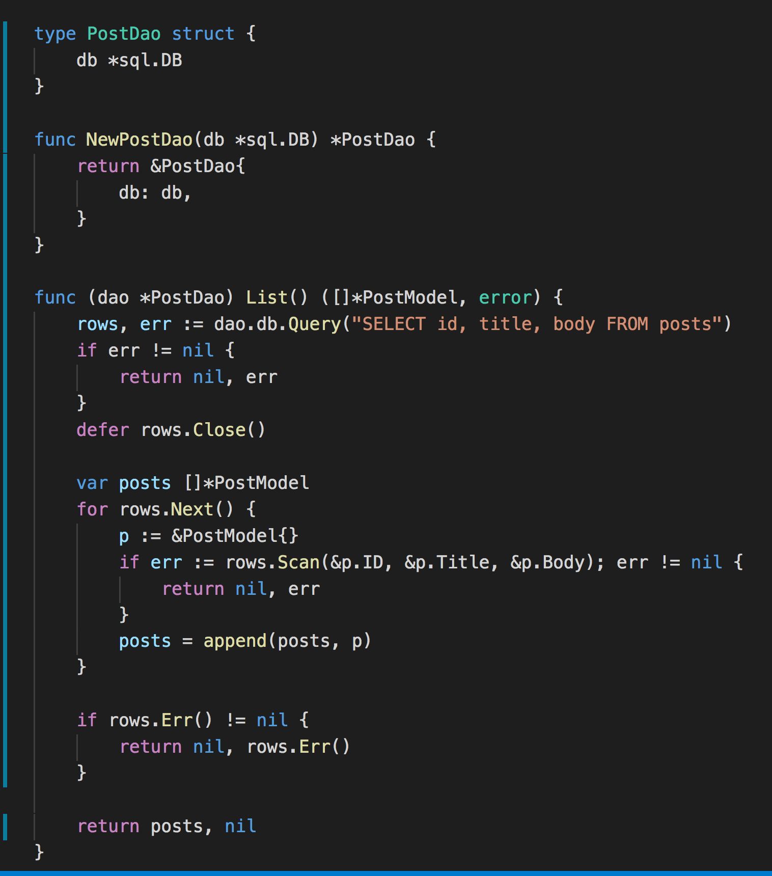
SQLMock
A example about PostDAO implement

Slide 32
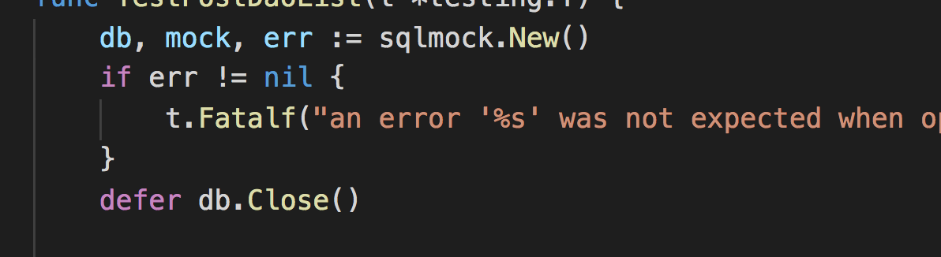
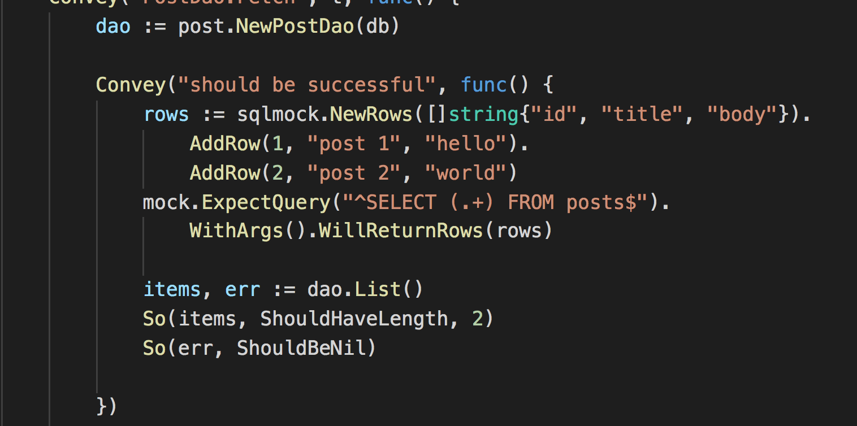
SQLMock

Slide 33
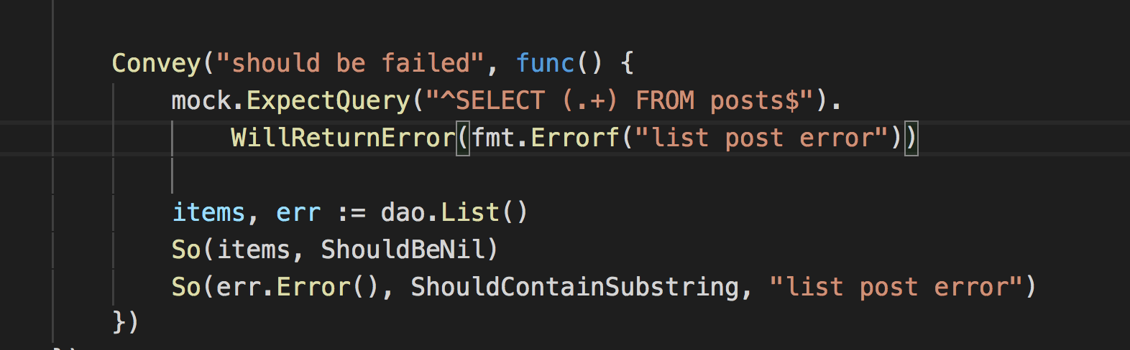
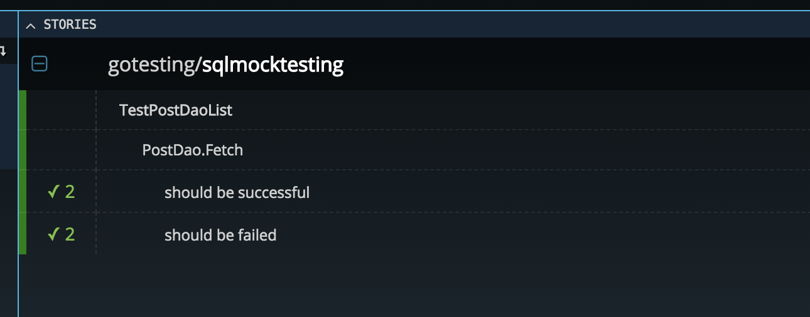
SQLMock

Slide 34
Testing with Docker

Slide 35
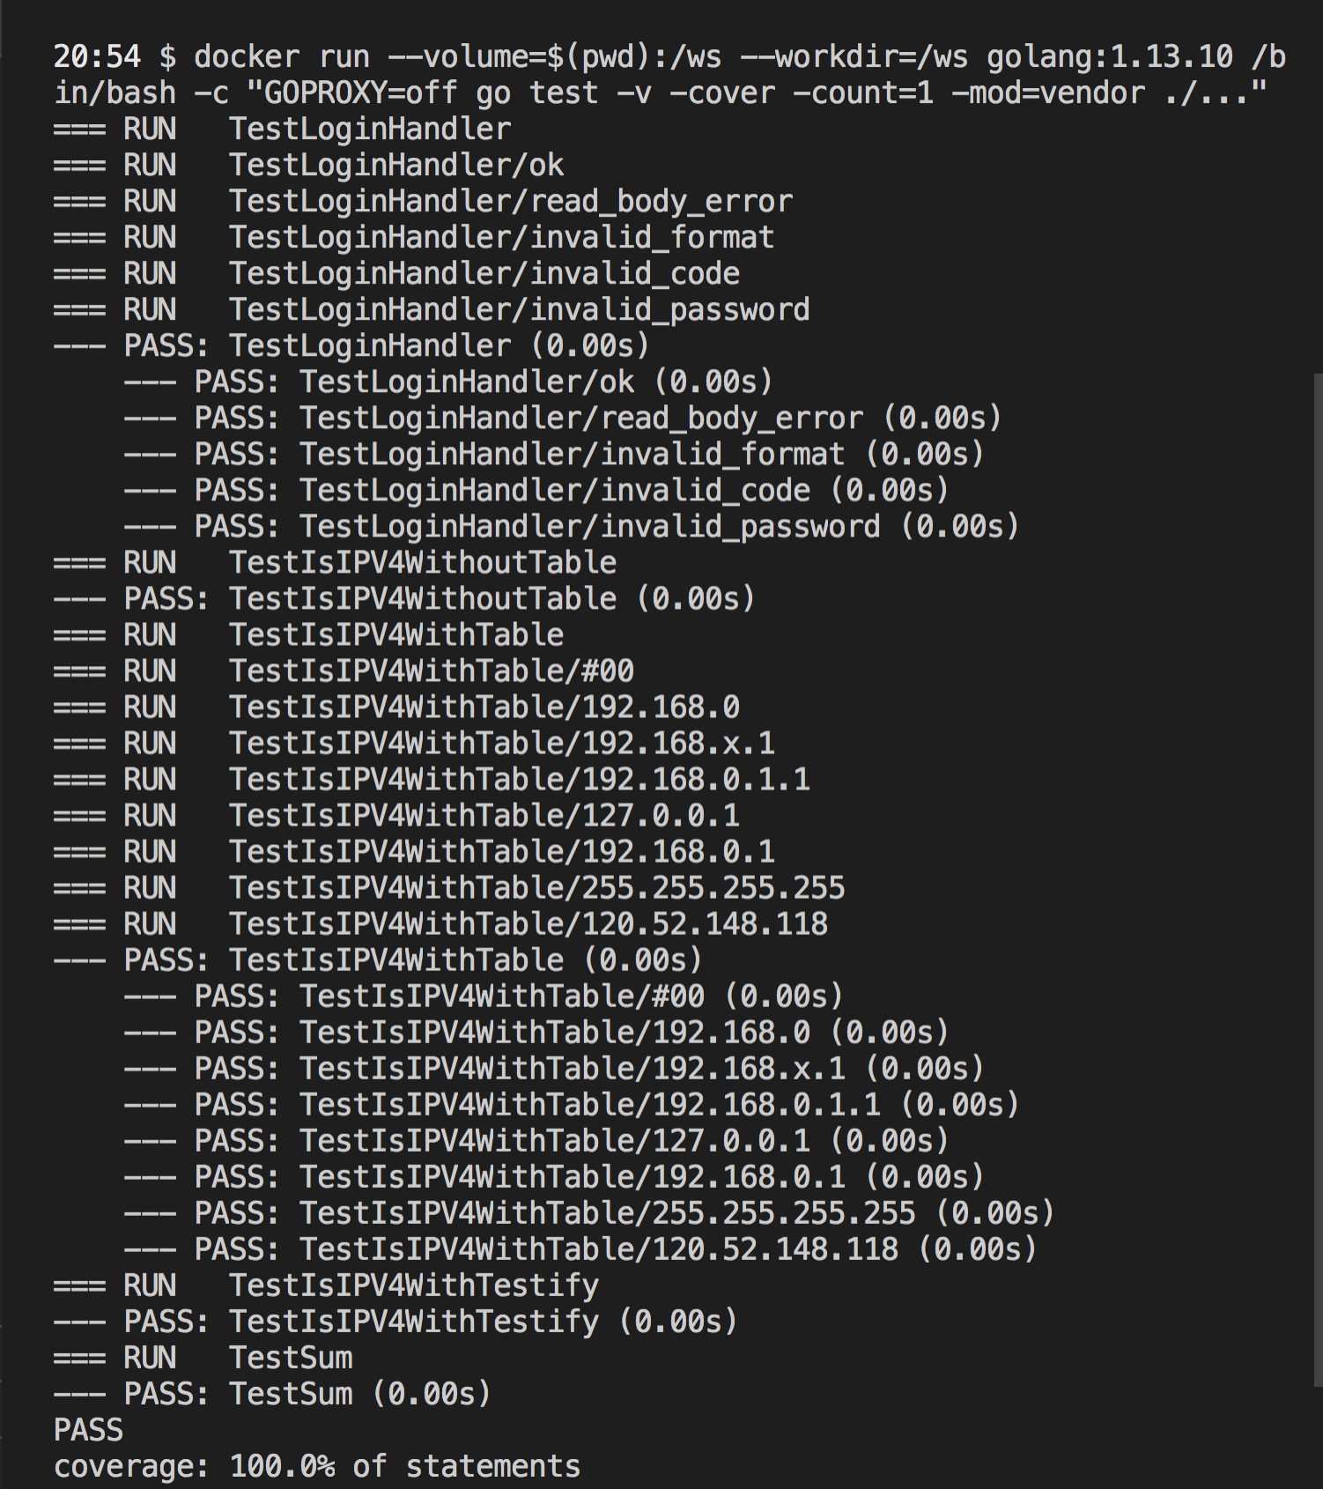
Go docker image
https://hub.docker.com/_/golang
A example to run our tests
docker run --volume=$(pwd):/ws --workdir=/ws golang:1.13.10 /bin/bash -c "GOPROXY=off go test -v -cover -count=1 -mod=vendor ./...

Slide 36
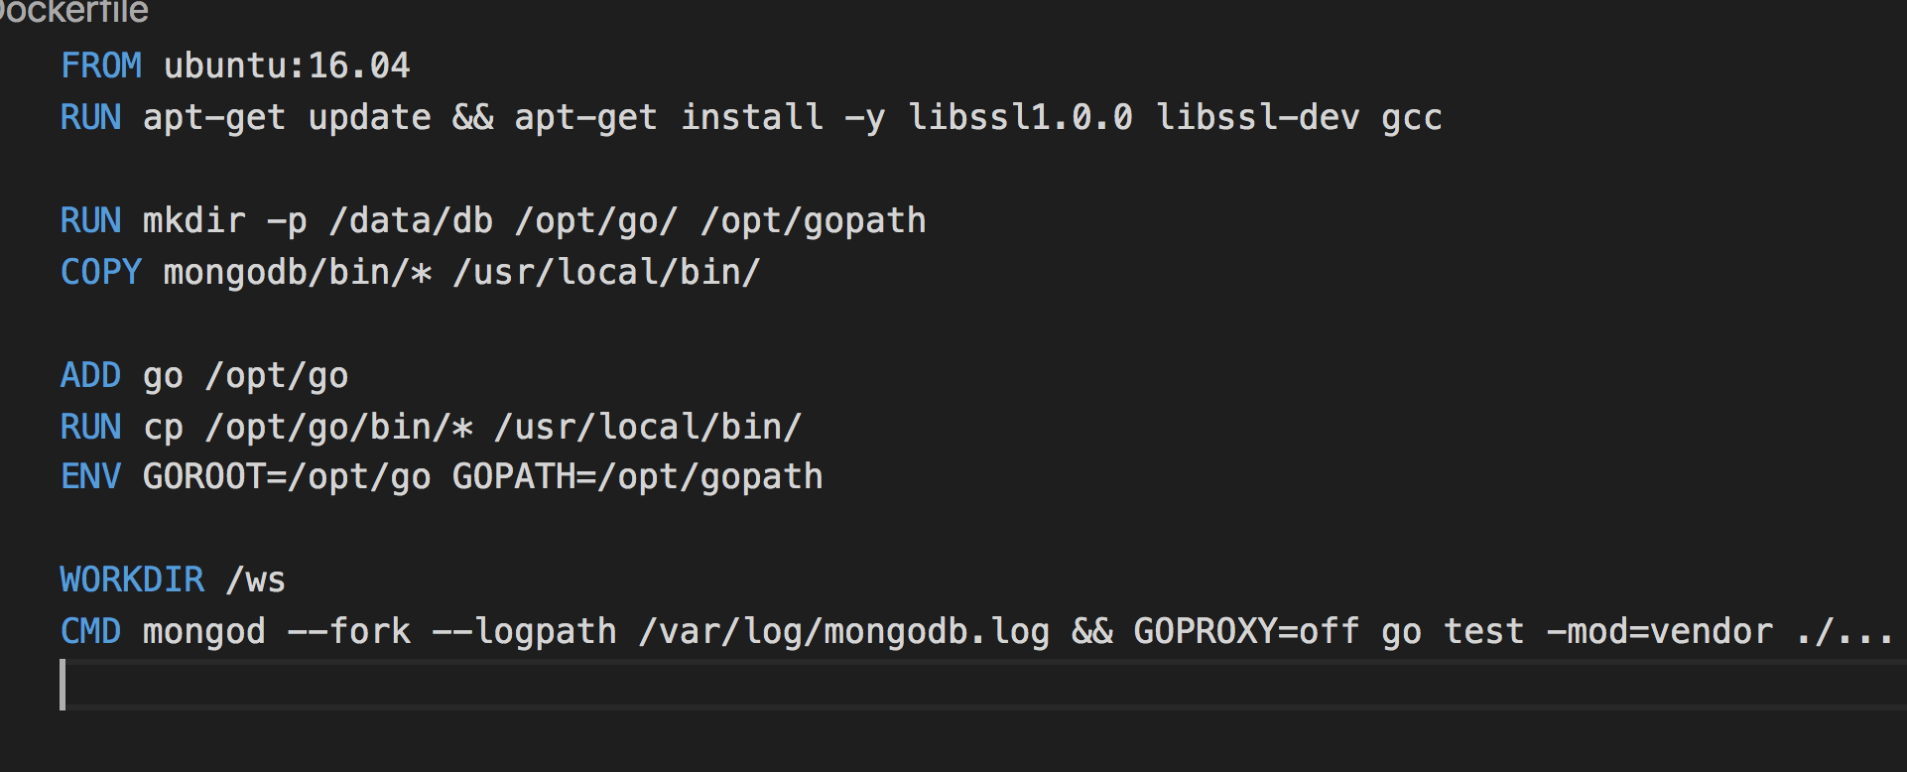
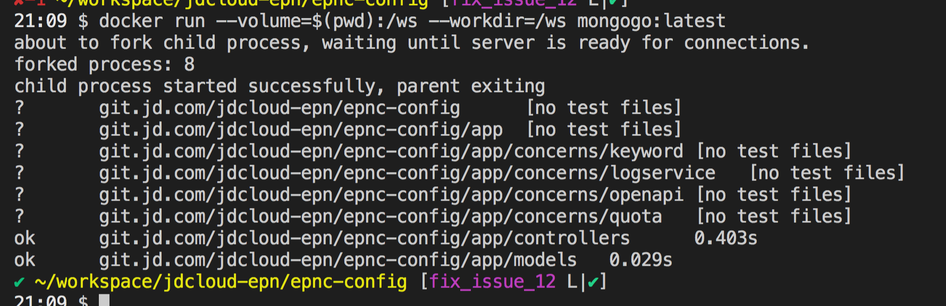
Custom docker image
A example to run our tests with MongoDB

Slide 37
Conclusion
Unit test should be a consensus
Unit test in go is easy
Mock make our testing efficient
Service should be an interface for mock friendly
Standard lib is good enough (table testing, testing HTTP)
Other frameworks make testing better and documentation
Docker can be used for more complex environment

Slide 38
Thanks you! Code at https://github.com/songjiayang/gotesting

